Slide 1
EE746 Neuromorphic Engineering Lecture 3b: Learning
Udayan Ganguly
udayan@ee.iitb.ac.in
Oct, 12, 2023
This follows Purves Ch 24: Plasticity of Mature Synapses and Circuits
Taylor book Ch 2.3 Basic Synaptic Mechanisms
You can also read https://neuronaldynamics.epfl.ch/online/ a description on models 19 Synaptic Plasticity and Learning

Slide 2
Topics
Behavior modification
Short vs long term:
Facilitation/Depression vs. PTP
Short Term P/D (ms-s):
Mechanisms
Long Term P/D (s-years)
Synapse changes & Mechanism
Model
Neuronal connections change by lack of use / intense usage
STDP has various types

Slide 3
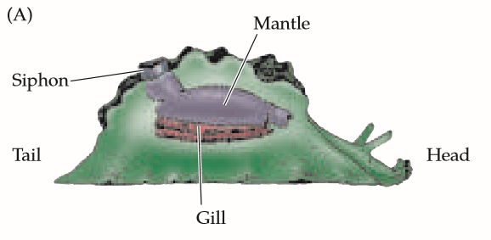
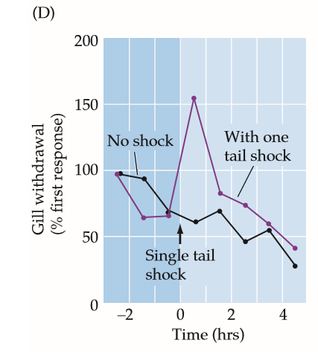
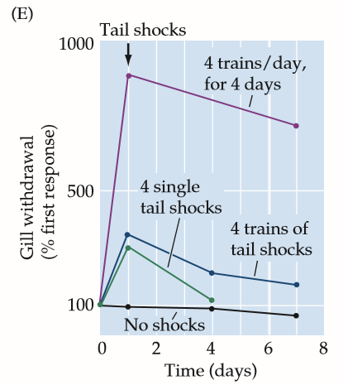
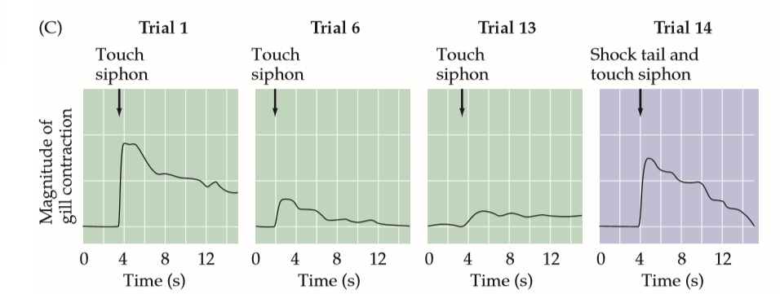
Habituation and Sensitization
Squire & Kandel 1999
Non-noxious touch causes habituation
Touch (non-noxious experience) causes response reduction i.e. habituation (trial 1-13)
Single shock (noxious experience) + touch (non-noxious experience) increase gill contraction (trial 14) ; But then habituation sets in with 1 hour
4 trains of shocks + touch is remembered for > 7 days
4 trains /day * 4 days is remembered with 5x increase in response
Harmless experience can be used as trigger to strong response due to noxious short/long memory association even in slugs
Notes:
One of the most successful examples of this approach has been that of Eric Kandel and his colleagues at Columbia University using the marine mollusk Aplysia californica in 1999. This sea slug has only a few tens of thousands of neurons, many of which are quite large (up to 1 mm in diameter) and in stereotyped locations within the ganglia that make up the animal’s nervous system (Figure 24.1B). These attributes make it practical to monitor the electrical and chemical signaling of specific, identifiable nerve
cells, and to define the synaptic circuits involved in mediating the limited behavioral repertoire of Aplysia.

Slide 4
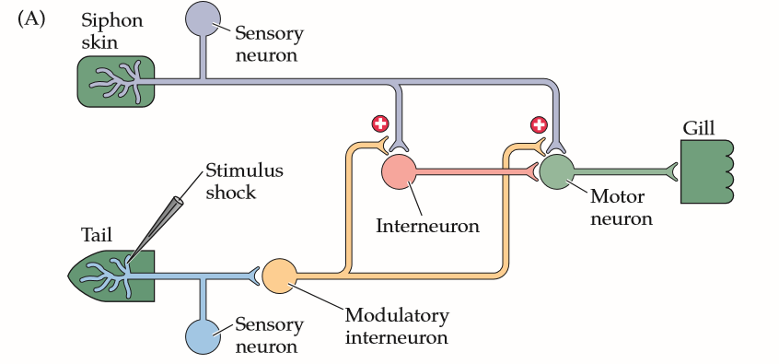
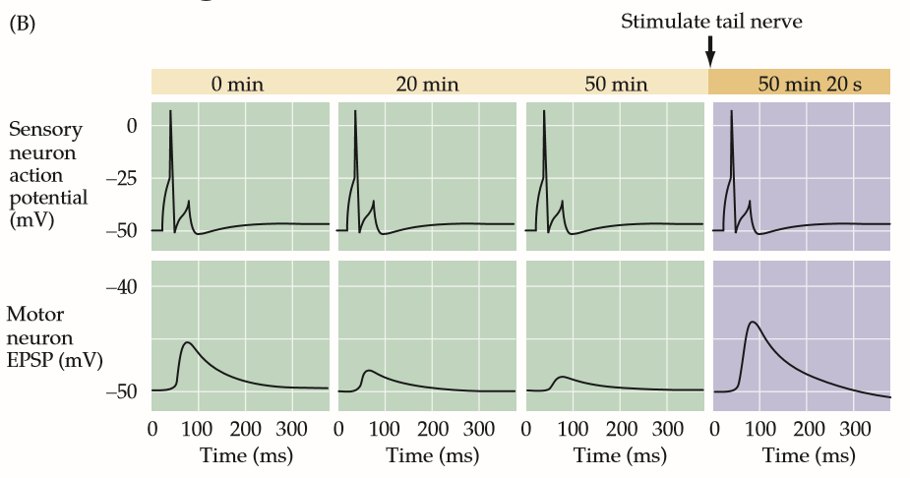
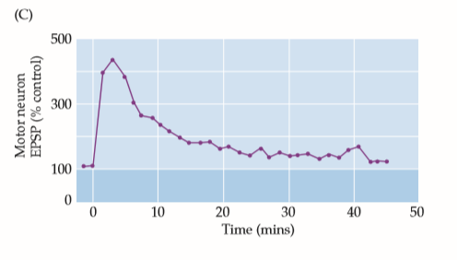
Neuronal re-wiring i.e. synaptic change
During habituation, the simple neuron circuit consists of
(a) Sensor
(b) Interneuron
(c) Motor
This system “tires” out (we will see how later).
For training, additional neurons are recruited to increase the response.
How does tail shock enhance siphon touch based gill withdrawal?
(a) By using tail neuron spiking to potentiate motor neuron
OR
(b) by strengthening siphon skin synapse

Slide 5
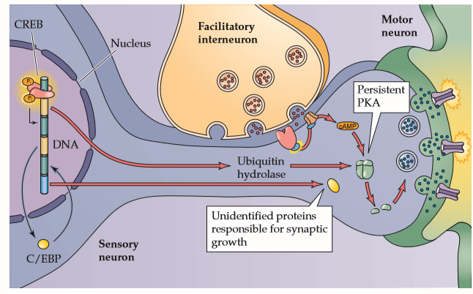
Short and Long Term P/D
In short term memory, it is more chemical transient signal based e.g.
NT depletion will reduce signal;
Increase can be due to more neurons participating
In long term, change in genetic expression (chemical & structural changes) occur.

Slide 6
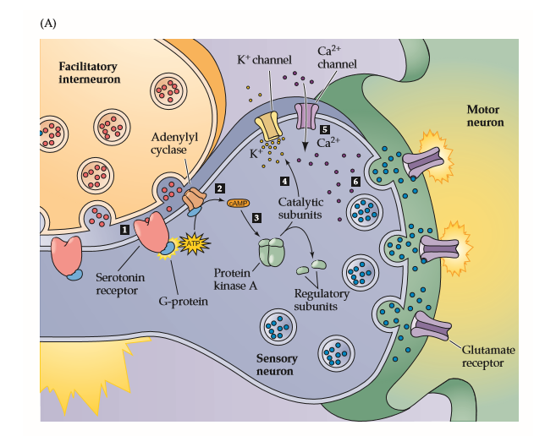

Short Term Memory
Serotonin released by the facilitatory interneurons binds to G-proteincoupled receptors on the presynaptic terminals of the siphon sensory neurons (step 1),
which stimulates production of the second messenger, cAMP (step 2).
cAMP binds to the regulatory subunits of protein kinase A (PKA; step 3),
liberating catalytic subunits of PKAthat are then able to phosphorylate several proteins, probably including K+ channels (step 4).
The net effect of the action of PKAis to reduce the probability that the K+ channels open during a presynaptic action potential. This effect prolongs the presynaptic action potential, thereby opening more presynaptic Ca2+ channels (step 5).
Finally, the enhanced influx of Ca2+ into the presynaptic terminals increases the amount of transmitter released onto motor neurons during a sensory neuron action potential (step 6).
Chemicals (Seratonin) from Facilitatory neurons prevent K channel opening; This prolongs AP to cause more Ca to come in;
This causes prolonged NT release;
[Ca] increase is progressive.

Slide 7
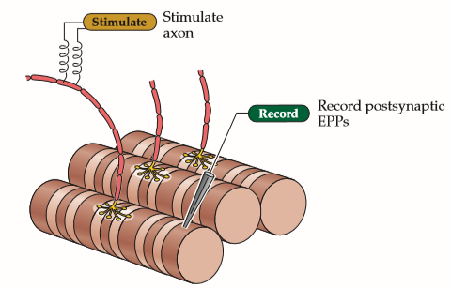
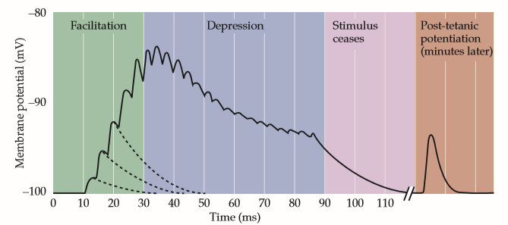
Short Term Plasticity (STP)
at neuromuscular synapse
After Katz, 1966
10-100 Millisecond timescale EPP sensitization : Facilitation and Depression
1-10 Minutes timescale EPP sensitization: Post Tetanic Potentiation
HF: 250Hz
Ca build up
NT exhaustion/post synapse
PTP – stronger synapse
Notes:
Synaptic facilitation, which is a transient increase in synaptic strength, occurs when two or more action potentials invade the presynaptic terminal in close succession. Facilitation results in more neurotransmitter being released by each succeeding action potential, causing the postsynaptic end plate potential (EPP) to increase progressively. Synaptic facilitation is most likely the result of prolonged elevation of presynaptic calcium levels following synaptic activity. Although the entry of Ca2+ into the presynaptic terminal occurs within a millisecond or two after an action potential invades (see Chapter 5), the mechanisms that return Ca2+ to resting levels are much slower. Thus, when action potentials arrive close together in time, calcium builds up within the terminal and allows more neurotransmitter to be released by a subsequent presynaptic action potential. Ahigh-frequency burst of presynaptic action potentials (referred to as tetanus) can yield an even more prolonged elevation of presynaptic calcium levels, causing another form of synaptic plasticity called post-tetanic potentiation (PTP). PTP is delayed in its onset and typically enhances transmitter release for up to a few minutes after the train of stimuli ends. The difference (millisecond vs minutes) in duration distinguishes PTP from synaptic facilitation. PTP also is thought to arise from calcium-dependent processes, perhaps including activation of presynaptic protein kinases, that enhance the ability of incoming calcium ions to trigger fusion of synaptic vesicles with the plasma membrane.

Slide 8
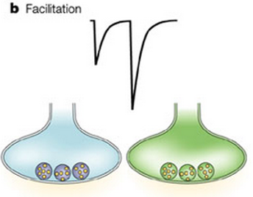
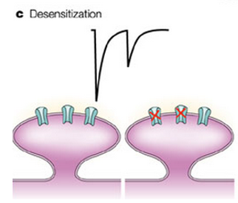
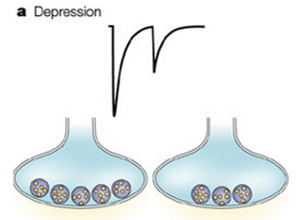
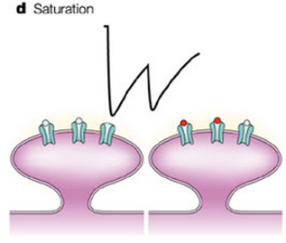
Origin of Short term P/D: Not permanent
Presynaptic
Postsynaptic
Ca enhancement with initial repeated firing
Channels become unresponsive (‘’tired’’)
Presynaptic
Postsynaptic
NT vesicles are depleted with longer repeated firing
Channels cannot follow the spiking rate “refractory”
: Nature Reviews Neuroscience (August 2004)

Slide 9
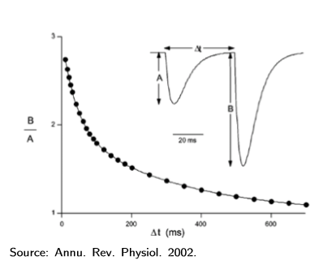
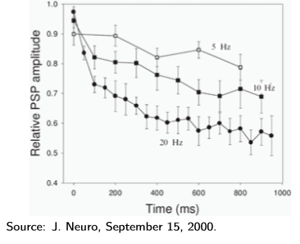
Timescale of STP/STD is <1mins

Slide 10
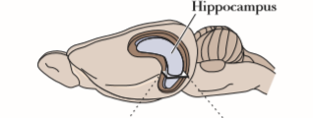
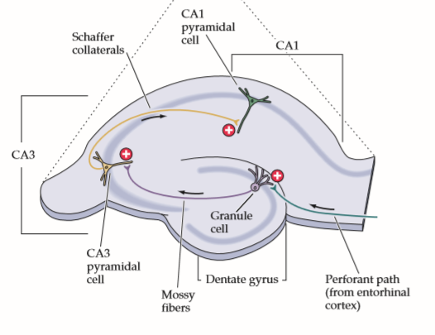
Hippocampus Layers in Rabbit
Terje Lomo and Timothy Bliss, 1960
The layered arrangement of neurons allows the hippocampus to be sectioned such that most of the relevant circuitry is left intact.
In such preparations, the cell bodies of the pyramidal neurons lie in a single densely packed layer that is readily apparent
Notes:
Diagram of a section through the rodent hippocampus showing the major regions, excitatory pathways, and synaptic connections. Long term potentiation has been observed at each of the three synaptic connections shown here.
This layer is divided into several distinct regions, the major ones being CA1 and CA3. “CA” refers to cornu Ammon, the Latin for Ammon’s horn—the ram’s horn that resembles the shape of the hipocampus. The dendrites of pyramidal cells in the CA1 region form a thick band (the stratum radiatum), where they receive synapses from Schaffer collaterals, the axons of pyramidal cells in the CA3 region. Much of the work on LTP has focused on the synaptic connections between the Schaffer collaterals and CA1 pyramidal cells. Electrical stimulation of Schaffer collaterals generates excitatory postsynaptic potentials (EPSPs) in the postsynaptic CA1 cells (Figure 24.6A,B)

Slide 11
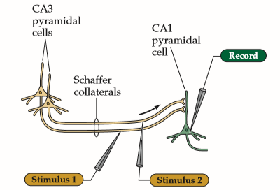
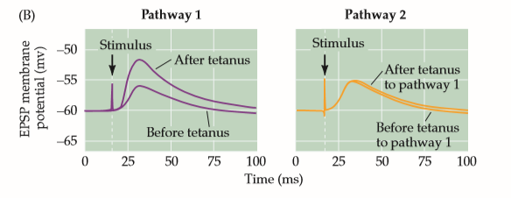
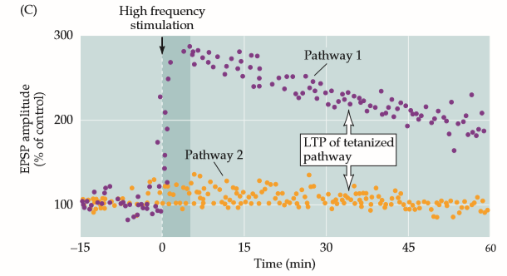
Long term potentiation (LTP> Hrs)
https://www.ncbi.nlm.nih.gov/pmc/articles/PMC1350458/pdf/jphysiol00958-0128.pdf
a few seconds of high-frequency electrical stimulation can enhance synaptic transmission in the rabbit hippocampus for days or even weeks
1 hr
Write down your observations Weak stimulation (3 Hz) no LTP
Stimulated synapse (20 Hz – 2 min) shows Post tetanic potentiation (PTP) based LTP which persists for several hours;
Non-stimulated synapse is unaffected.
Is the post neuron spiking if the pre neuron spiked at 20Hz?
Bliss & Lomo et al 1973
Freq. 1-3Hz
Freq. 20Hz

Slide 12
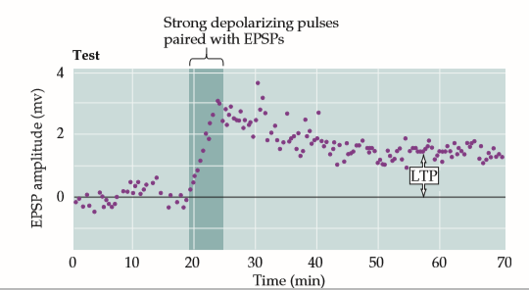
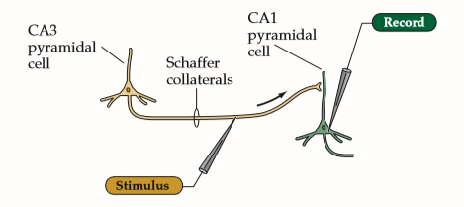
Effect of post-synaptic spike
Gustafsson et al., 1987
Without CA1 stimulus, if only CA3 stimulus is added no LTP occurs.
If CA1 is added to produce depolarization along with CA3 stimulus, then LTP occurs
Will it cause spiking in CA1 spontaneously?
Low probability – depends on synaptic strength
Pairing presynaptic and postsynaptic activity causes LTP.
Notes:
Pairing presynaptic and postsynaptic activity causes LTP. Single stimuli applied to a Schaffer collateral synaptic input evokes EPSPs in the postsynaptic CA1 neuron. These stimuli alone do not elicit any change in synaptic strength. However, when the CA1 neuron’s membrane potential is briefly depolarized (by applying current pulses through the recording electrode) in conjunction with the Schaffer collateral stimuli, there is a persistent increase in the EPSPs. (After Gustafsson et al., 1987.)
If a single stimulus to the Schaffer collaterals—which would not normally elicit LTP—is paired with strong depolarization of the postsynaptic CA1 cell, the activated Schaffer collateral synapses undergo LTP. The increase occurs only if the paired activities of the presynaptic and postsynaptic cells are tightly linked in time, such that the strong postsynaptic depolarization occurs within about 100 ms of presynaptic transmitter release.

Slide 13
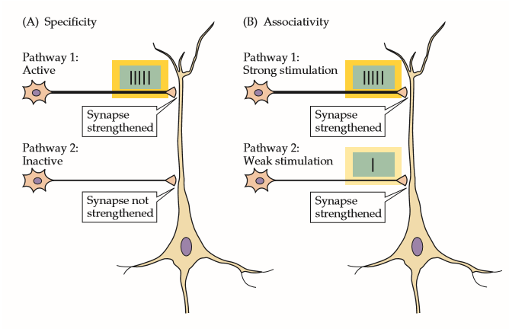
Specificity & Associativity
(A) Strong activity initiates LTP at active synapses (pathway 1) without initiating LTP at nearby inactive synapses (pathway 2).
(B) Weak stimulation of pathway 2 alone does not trigger LTP. However, when the same weak stimulus to pathway 2 is activated together with strong stimulation of pathway 1, both sets of synapses are strengthened.
Notes:
Properties of LTP at CA1 pyramidal neuron receiving synaptic inputs from two independent sets of Schaffer collateral axons. (A) Strong activity initiates LTP at active synapses (pathway 1) without initiating LTP at nearby inactive synapses (pathway 2). (B) Weak stimulation of pathway 2 alone does not trigger LTP. However, when the same weak stimulus to pathway 2 is activated together with strong stimulation of pathway 1, both sets of synapses are strengthened.

Slide 14
Summary of conditions for LTP vs. no LTP
Pre Neuron 1 |  | Post Neuron | LTP | No LTP | Type of Function
Low Freq |  |  |  | 1, 2 | No LTP
Low Freq |  | Depolarization | 1 | 2 | coincidence
??
Pre Neuron 1 | Pre-neuron 2 | Post Neuron | LTP | No LTP | Type of Function
High Freq |  |  | 1 | 2 | Specificity
High Freq | Low Freq |  | 1,2 |  | Association
??
Write down the questions our mechanism must answer?
1. How does LTP occur when pre-neuron spikes fast and not when slow ?
2. How does LTP occur only when pre-neuron fires & post neuron depolarizes simultaneously?
3. How does this pre-neuron 2 know that pre-neuron 1 is spiking strongly?
4. Is this consistent with Q1
Clearly pre & post synaptic potential enables LTP

Slide 15
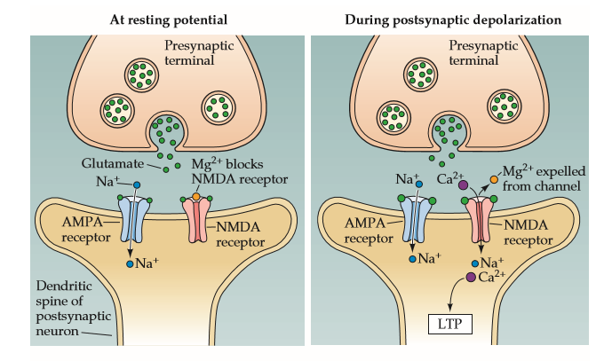
Molecular Mech. Step 1: Coincidence
.. (After Nicoll et al., 1988.)
The NMDA receptor channel can open only during depolarization of the postsynaptic neuron from its normal resting level
Depolarization expels Mg2+ from the NMDA channel, allowing current to flow into the postsynaptic cell. This leads to Ca2+ entry, which in turn triggers LTP
What is the molecular AND operation going on??
Notes:
NMDA receptor thus behaves like a molecular “and” gate: The channel opens (to induce LTP) only when glutamate is bound to NMDA receptors and the postsynaptic cell is depolarized to relieve the Mg2+ block of the NMDAchannel. Thus, the NMDAreceptor can detect the coincidence of two events.

Slide 16
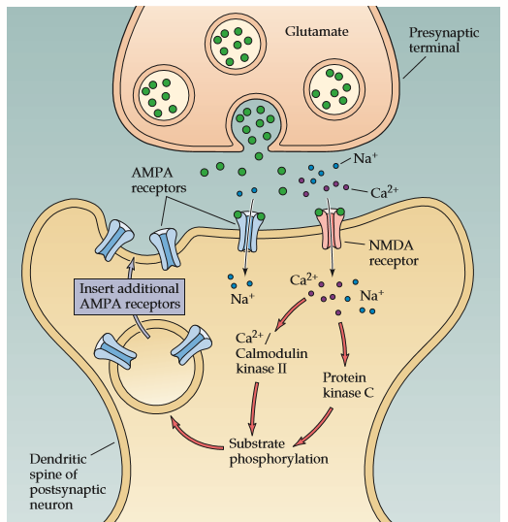
Molecular Mech. Step 2: Synapse strengthening
Mechanisms underlying LTP.
During glutamate release, the NMDA channel opens only if the postsynaptic cell is sufficiently depolarized.
The Ca2+ ions that enter the cell through the channel activate postsynaptic protein kinases. (High amplitude Ca2+ rise)
These kinases may act post-synaptically to insert new AMPA receptors into the postsynaptic spine, thereby increasing the sensitivity to glutamate.

Slide 17
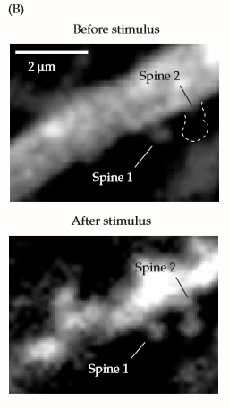
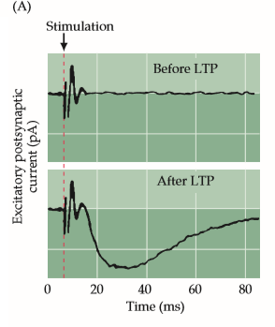

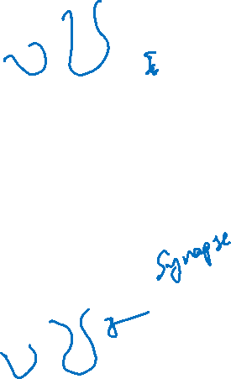
Synaptic Modification

Slide 18
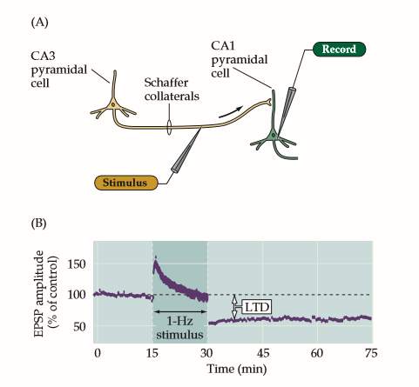
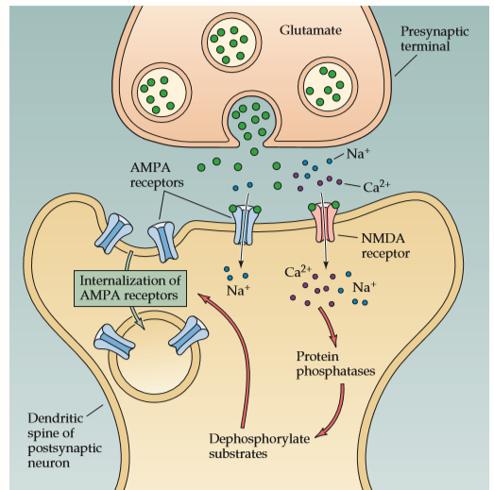
LTD Mechanism
Mulkey et al., 1993.
Long-term synaptic depression in the hippocampus.
Electrophysiological procedures used to monitor transmission at the Schaffer collateral synapses on to CA1 pyramidal neurons.
Low-frequency stimulation (1 per second) of the Schaffer collateral axons causes a long-lasting depression of synaptic transmission.
Mechanisms underlying LTD. A low-amplitude rise in Ca2+ concentration in the postsynaptic CA1 neuron activate postsynaptic protein phosphatases,
which cause internalization of postsynaptic AMPA receptors, thereby decreasing the sensitivity to glutamate released from the Schaffer collateral terminals.

Slide 19
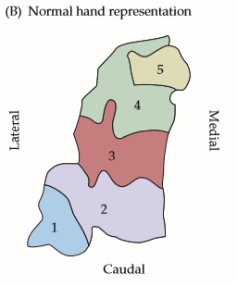
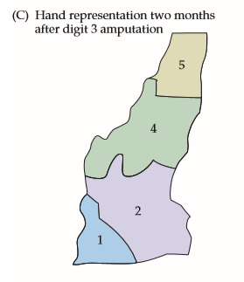
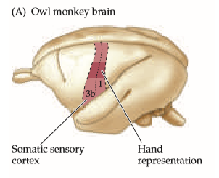
Plasticity in behavior due to underuse
Recruiting more neurons for existing tasks (reallocation from non-existing task)
Functional changes in the somatic sensory cortex of an owl monkey following amputation of a digit. (A) Diagram of the somatic sensory cortex in the owl monkey, showing the approximate location of the hand representation.
The hand representation in the animal before amputation; the numbers correspond to different digits.
The cortical map determined in the same animal two months after amputation of digit 3. The map has changed substantially; neurons in the area formerly responding to stimulation of digit 3 now respond to stimulation of digits 2 and 4.
Why is this re-mapping and not anything else e.g. encroachment?
Notes:
All regions change. It is not just neighboring regions encroach signal free region.

Slide 20
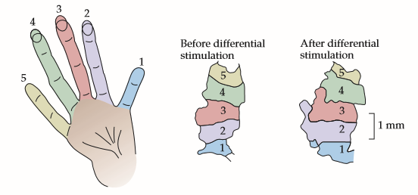

Plasticity of behavior due to training
Recruiting more neurons for intensive tasks (reallocation from non-intensive task)
Functional expansion of a cortical representation by a repetitive behavioral task. An owl monkey was trained in a task that required heavy usage of digits 2, 3, and occasionally 4.
The map of the digits in the primary somatic sensory cortex prior to training is shown.
After several months of “practice,” a larger region of the cortex contained neurons activated by the digits used in the task.
Note that the specific arrangements of the digit representations are somewhat different from the monkey shown in Figure 24.14, indicating the variability of the cortical representation in particular animals. (After Jenkins et al., 1990.)

Slide 21
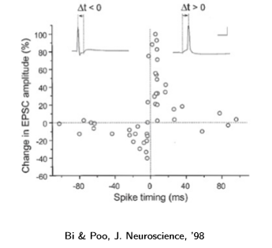
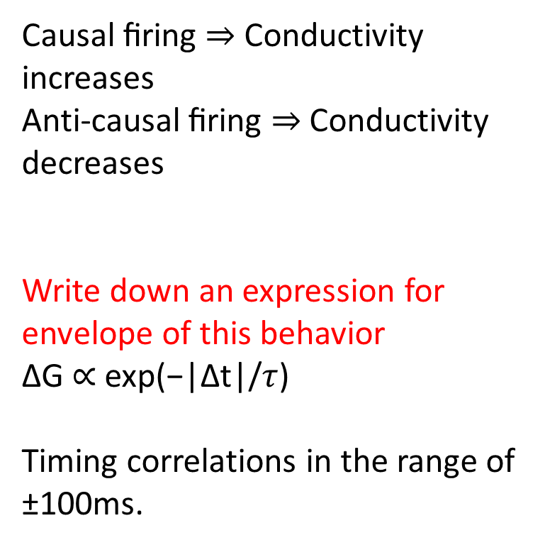
Spike Time dependent plasticity
Causal ﬁring ⇒ Conductivity increases
Anti-causal ﬁring ⇒ Conductivity decreases
Write down an expression for envelope of this behavior
∆G ∝ exp(−|∆t|/$τ$)
Timing correlations in the range of ±100ms.

Slide 22

















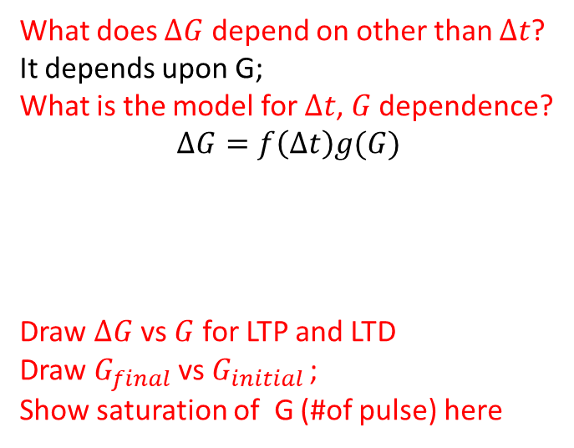
What does $ΔG$ depend upon?
Fixed $Δt$
Long term Potentiation
(LTP)
$$G_{final}$$
$$∆G$$
$$ΔG$$
1:1
$∆$t>0
$$??$$
$G_{initial }$
$∆$t=$t_{post}−{ t}_{pre}$
$∆$t<0
Long term Depression
(LTD)
What does $ΔG$ depend on other than $Δt$?
It depends upon G;
What is the model for $Δt$, $G$ dependence?
$$ΔG=f\left(Δt\right)g(G)$$
Draw $ΔG$ vs $G$ for LTP and LTD
Draw $G_{final}$ vs $G_{initial }$;
Show saturation of G (#of pulse) here
$$V$$
LTP
LTD
$$time$$
$$G$$
$$ΔG_{LTD}^{max}$$
$$ΔG_{LTP}^{max}$$
$$time$$
$G$ has a finite range: $G_{max}−G_{min}$

Slide 23


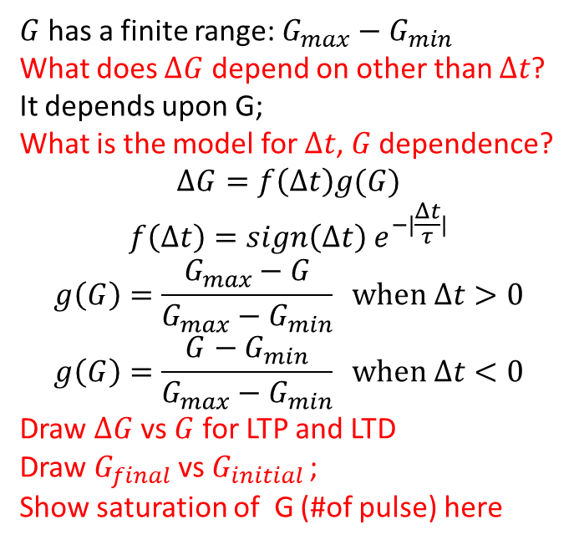
What does $ΔG$ depend upon?
Fixed $Δt$
Long term Potentiation
(LTP)
$$∆G$$
$$ΔG$$
$∆$t>0
$$G$$
$$G_{final}$$
$$??$$
$∆$t=$t_{post}−{ t}_{pre}$
1:1
$∆$t<0
Long term Depression
(LTD)
$G_{initial }$
$G$ has a finite range: $G_{max}−G_{min}$
What does $ΔG$ depend on other than $Δt$?
It depends upon G;
What is the model for $Δt$, $G$ dependence?
$$ΔG=f\left(Δt\right)g(G)$$
$$f\left(Δt\right)=sign\left(Δt\right) e^{−|\frac{Δt}{τ}|}$$
$$g\left(G\right)=\frac{G_{max}−G}{G_{max}−G_{min}} when Δt>0$$
$$g\left(G\right)=\frac{G−G_{min}}{G_{max}−G_{min}} when Δt<0$$
Draw $ΔG$ vs $G$ for LTP and LTD
Draw $G_{final}$ vs $G_{initial }$;
Show saturation of G (#of pulse) here
$$V$$
LTP
LTD
$$time$$
$$G$$
$$ΔG_{LTD}^{max}$$
$$ΔG_{LTP}^{max}$$
$$time$$

Slide 24
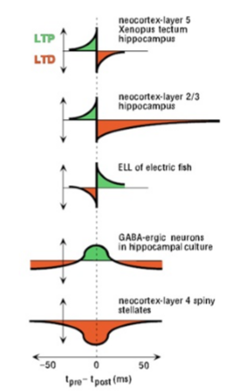
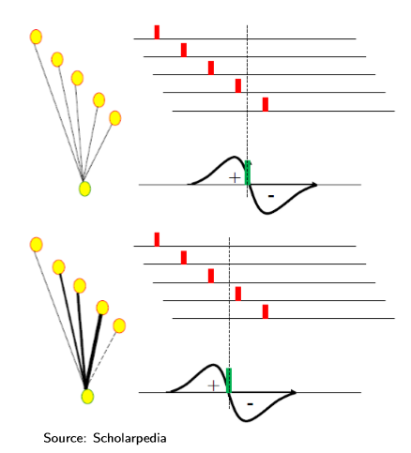
Various STDP behaviors
Notes:
What is the reason for

Slide 25
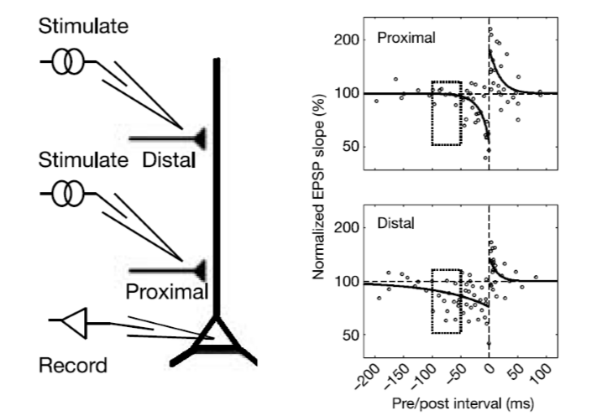
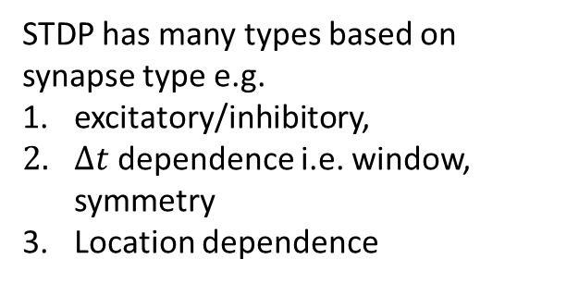

STDP mechanism
Location dependent STDP: What can this enable?
Spatial structure dependent learning is possible; How specifically? Observe the STDP pattern and comment;
Proximal pre-neurons produce stronger change with shorter symmetric window; Distal STDP has longer LTD window in time;
STDP has many types based on synapse type e.g.
excitatory/inhibitory,
$Δt$ dependence i.e. window, symmetry
Location dependence

Slide 26
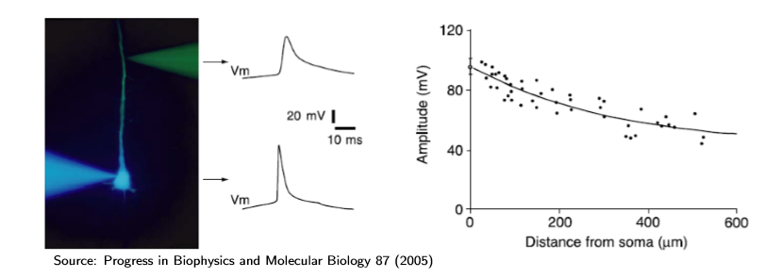
Back-propagating AP

Slide 27
Summary
Even simple animals can be trained- behavior modification by Habituation and Sensitization
STP: short term changes are <1s
Facilitation & Depression (cf. PTP)
LTP: Long term (>1s – years)
caused by various inputs
by HF only, Selective
pre-post coincidental spikes: coincidental
HF synapse affects LF synapse: associative
Neuronal connections change by lack of use / intense usage
STDP has various types with spatio-temporal, coincident, associative, selective dependence

